Slide 1
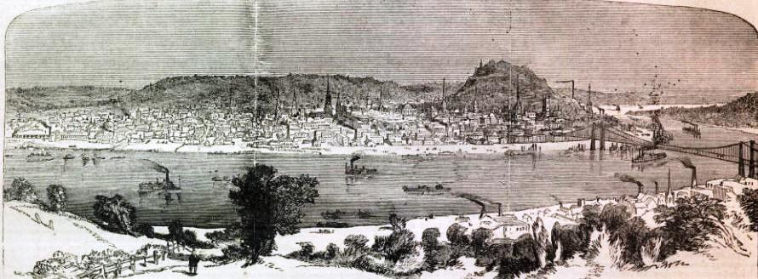
Spread of Cholera
Ben Lee, Dinushki De Livera, Lindsey Schneider
Following the disease to and from Cincinnati
Lithograph of Cincinnati - 1862

Slide 2
History
Native to India
First Pandemic (1817-1824) - spread through Asia and Mediterranean
Second Pandemic (1829-1851) - spread west to Europe, then across ocean to America.

Slide 3
1832 Epidemic
Disease arrived in New York from Europe
Spread by waterways
Down the Ohio River to Cincinnati (major river transport hub)
From Cincinnati, up and down the Mississippi
Spread over land from large cities to adjacent smaller cities
732 dead in Cincinnati

Slide 4
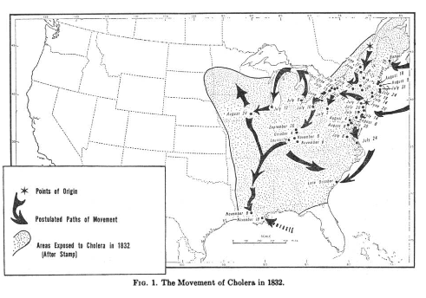
The Movement of Cholera in 1832

Slide 5
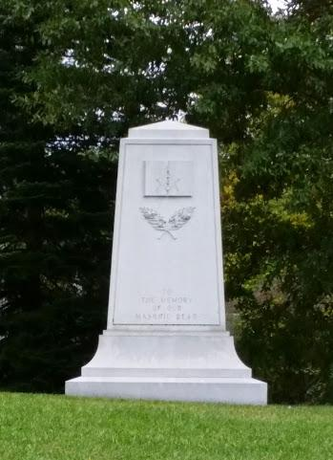
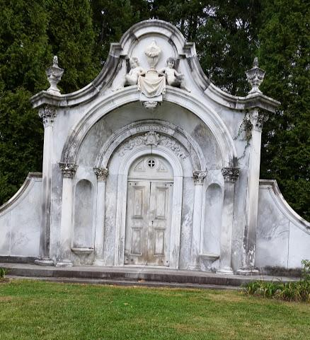
Spring Grove Cemetery
Created in 1844
Not specifically a cholera cemetery
Many prominent Cincinnatians and families affected by Cholera, laid to rest in Spring Grove

Slide 6
1849 Epidemic
Started in both New York and New Orleans
Three main paths
Up and down the Ohio and Mississippi rivers
Down the east coast
West on the California trail
Spread down urban hierarchy - big cities to smaller
Transportation better, distance less of a factor
6,000-8,000 dead

Slide 7
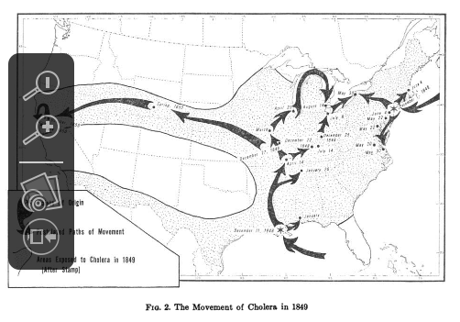
The Movement of Cholera in 1849

Slide 8
Spread in Ohio
Cincinnati vulnerable because it was a large city and a river transport hub
Canals provided transport throughout Ohio
Spread north on Illinois River to Chicago, then east through Great Lakes
Reached Sandusky, Ohio from lakes
400 dead, 3/4ths of population fled.

Slide 9
Sandusky Cholera Cemetery
Victims were buried
in a long trench, rather than
individual graves, at this
Harrison Street site.
It is Sandusky’s second
oldest cemetery.

Slide 10
1866 Epidemic
Started in New York, went to Cincinnati and then New Orleans
Similar paths to 1849
Spread down urban hierarchy
Distance even less a factor than 1849
At least 2,000 dead in Cincinnati

Slide 11
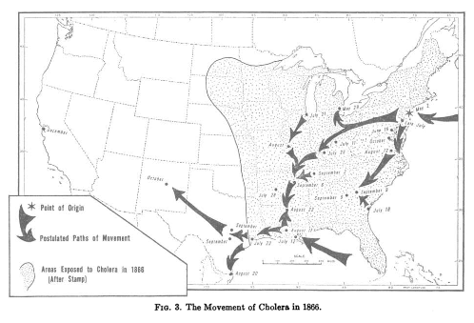
The Movement of Cholera in 1866

Slide 12
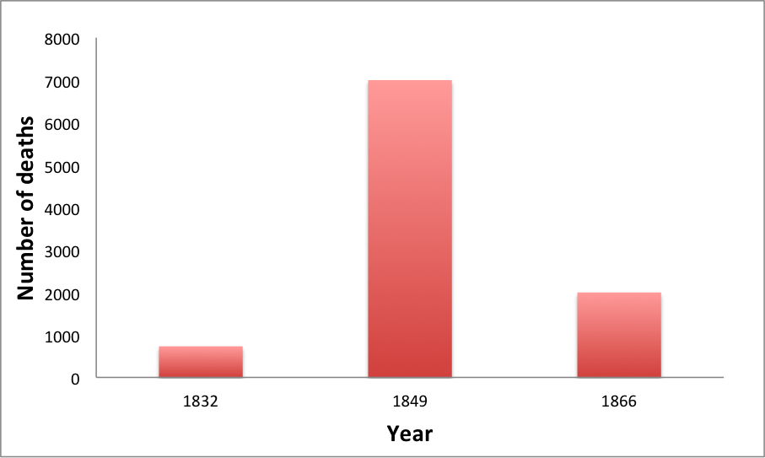
Number of Deaths in Cincinnati During Each Outbreak

Slide 13
Any Questions?

